Slide 1
SMARTBIN CLOUD · BOSSARD × D ONE · HSLU CASE STUDY
Wake up for picks,
not for noise
92%
of the wake-ups of a typical 20 kg scale find nothing
How each SmartBin scale can find its own sensor setting
−52% / −59%
empty wake-ups when a scale goes from setting 8 to 7 (20 kg / 6 kg)
1.5% → 27%
1.5% of the scales cause 27% of all weighings
Erenalp Çakıroğlu - Nikolaos Georgantopoulos
MSc Applied Information and Data Science · HSLU Lucerne
Notes:
Thank you for having us. This presentation is about the SmartBin scales.
Today most of their weighings find nothing.
We looked at 7.6 million weighings and found out why.
The three numbers on the right are the core.
Nine out of ten wake-ups of a typical 20 kg scale find nothing.
One step down on the setting removes about half of them. We measured that on real scales.
And a very small group of scales causes a quarter of all weighings.

Slide 2
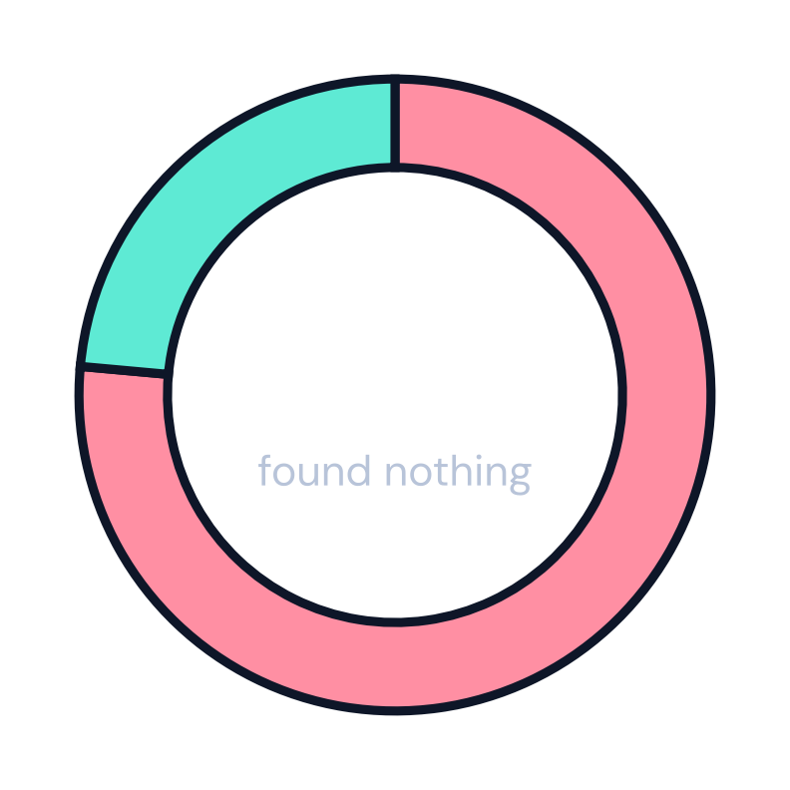
THE PROBLEM
3 out of 4 automatic weighings find nothing
1
Pick
2
Wake up
3
Weigh
4
Reorder
A worker takes parts from a bin.
A vibration sensor wakes the scale.
The scale weighs the bin.
ARIMS gets the new stock and reorders.
Too sensitive
Not sensitive enough
The scale wakes up, but nothing was taken. This loads the radio network, the cloud and ARIMS.
The scale sleeps through a pick. The stock level is wrong until the next weighing.
7.1 million automatic weighings, March to June 2022
Source: own analysis of the Bossard SmartBin data, 1 Mar to 20 Jun 2022 · case description Bossard / D ONE (2026) · Report §2, §4.1
2
Notes:
A SmartBin is a scale under a storage bin.
When a worker takes parts, a sensor feels the vibration and wakes the scale up.
The scale weighs the bin and sends the new stock level to ARIMS. ARIMS then reorders.
The problem is that three out of four of these weighings find nothing.
Each one loads the radio network, the cloud and ARIMS.
If we make the sensor less sensitive, it may sleep through a real pick.
Then the stock level is wrong for a while.
So the question is simple. How should the sensor be set?

Slide 3
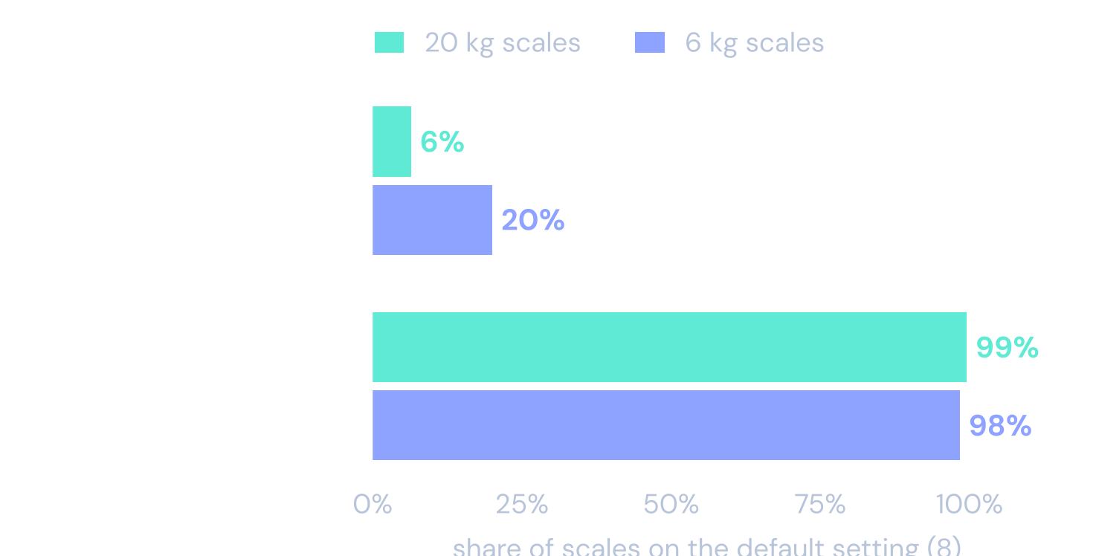
TODAY
Almost no scale misses picks. But almost every scale wakes up too often.
BOSSARD TARGET 1
At most half of the wake-ups may be empty
Typical scale today: 92% empty (20 kg), 74% (6 kg)
BOSSARD TARGET 2
At most 2 missed picks per week
Typical scale today: 0.1 a week (20 kg, about 1 every 8 weeks), 0.4 (6 kg, about 1 every 3 weeks)
A typical 20 kg scale wakes up empty 13.5 times a week and sees 1.5 real picks. There is room to turn the sensor down.
Source: own analysis of the Bossard SmartBin data, 1 Mar to 20 Jun 2022 · scales on the default setting (8) · Report §4.1
3
Notes:
This is the fleet today, on the factory setting.
Bossard has two targets. At most half of the wake-ups may be empty, and at most two missed picks per week.
The typical 20 kg scale has about ninety percent empty wake-ups. So almost no scale meets the first target.
Missed picks are rare. The typical 20 kg scale misses about one pick every eight weeks. So almost every scale meets the second target.
A typical 20 kg scale wakes up for nothing about 14 times a week and sees only one or two real picks.
So the sensor is set too sensitive. The question is how far we can turn it down before we start missing picks.

Slide 4
DATA AND APPROACH
We checked 7.6 million weighings and looked at every scale on its own
7.6 M
18,455
16 weeks
7,846
weighings
scales
March to June 2022
scales got a new setting in April
1
Check
2
Measure
3
Compare
We deleted only broken rows. 5.26 M of 7.6 M rows (69%) are used for the KPIs. The table is in the backup.
One result per scale and setting. We report the typical scale (the median), so a few noisy scales cannot distort the result.
In April, 7,846 scales got a new setting. We compare each one with itself before the change, minus the trend of scales that kept setting 8.
Python
DuckDB
Quarto
Tested on synthetic data first
Source: own analysis of the Bossard SmartBin data, 1 Mar to 20 Jun 2022 · Report §2 and §3, Appendix A
4
Notes:
We had 7.6 million weighings from 18,455 scales over 16 weeks.
First we checked the data. We deleted only rows that were clearly broken. About 70 percent of all rows go into the KPIs. The details are in the backup.
Then we measured each scale on its own, and we report the typical scale.
The most useful part of the data is April. Bossard gave 7,846 scales a new setting. So we can compare the same scale before and after, and remove the general trend with the scales that kept their setting.
Every effect in this presentation comes from that comparison on real scales.

Slide 5
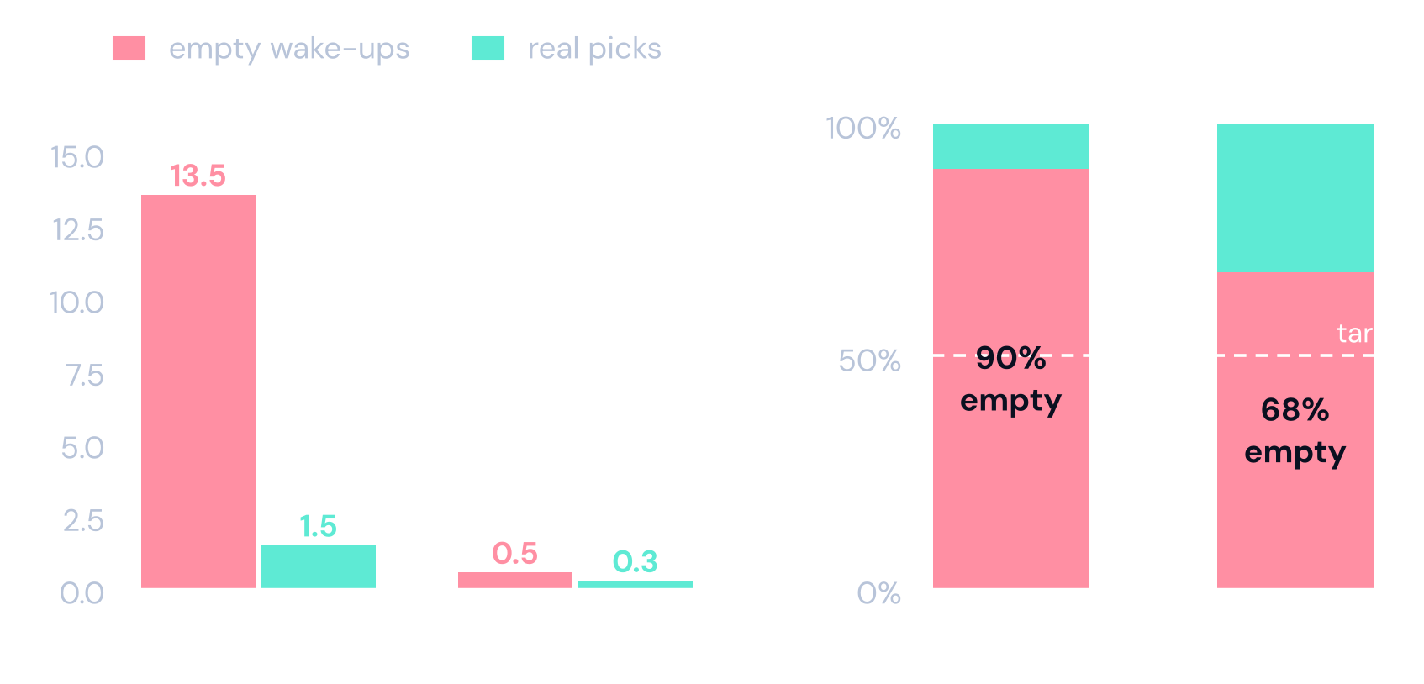
FINDING 1 · THE KPI
The current KPI looks best when the sensor barely reacts
WE SUGGEST: KPI 2.0
Count what really costs money
≤ 7
empty wake-ups per week
≤ 10%
of picks missed
≤ 2
missed picks per week
A typical 20 kg scale. On setting 1 the empty wake-ups almost disappear, but the KPI stays far above its target, because the real picks disappear too.
Bossard's target of 2 misses a week stays.
Source: own analysis of the Bossard SmartBin data, 1 Mar to 20 Jun 2022 · typical scale per setting · Report §4.3, §4.4, §6.1
5
Notes:
Bossard's KPI is a ratio. Empty wake-ups divided by all wake-ups.
Look at a typical 20 kg scale. On the default setting it wakes up empty about thirteen times a week, and sees one or two real picks. So about ninety percent of its wake-ups are empty.
On setting 1 the sensor barely reacts. Empty wake-ups almost disappear. But the real picks disappear too.
Because both numbers fall together, the ratio stays high. It moves from about ninety to about seventy percent, still far from the target.
So the ratio hides the real progress. It also punishes bins that are rarely used.
We suggest to add counts that reflect the real cost. Empty wake-ups per week, and the share of picks we miss. Bossard's target of two misses a week stays. We call this KPI 2.0.

Slide 6
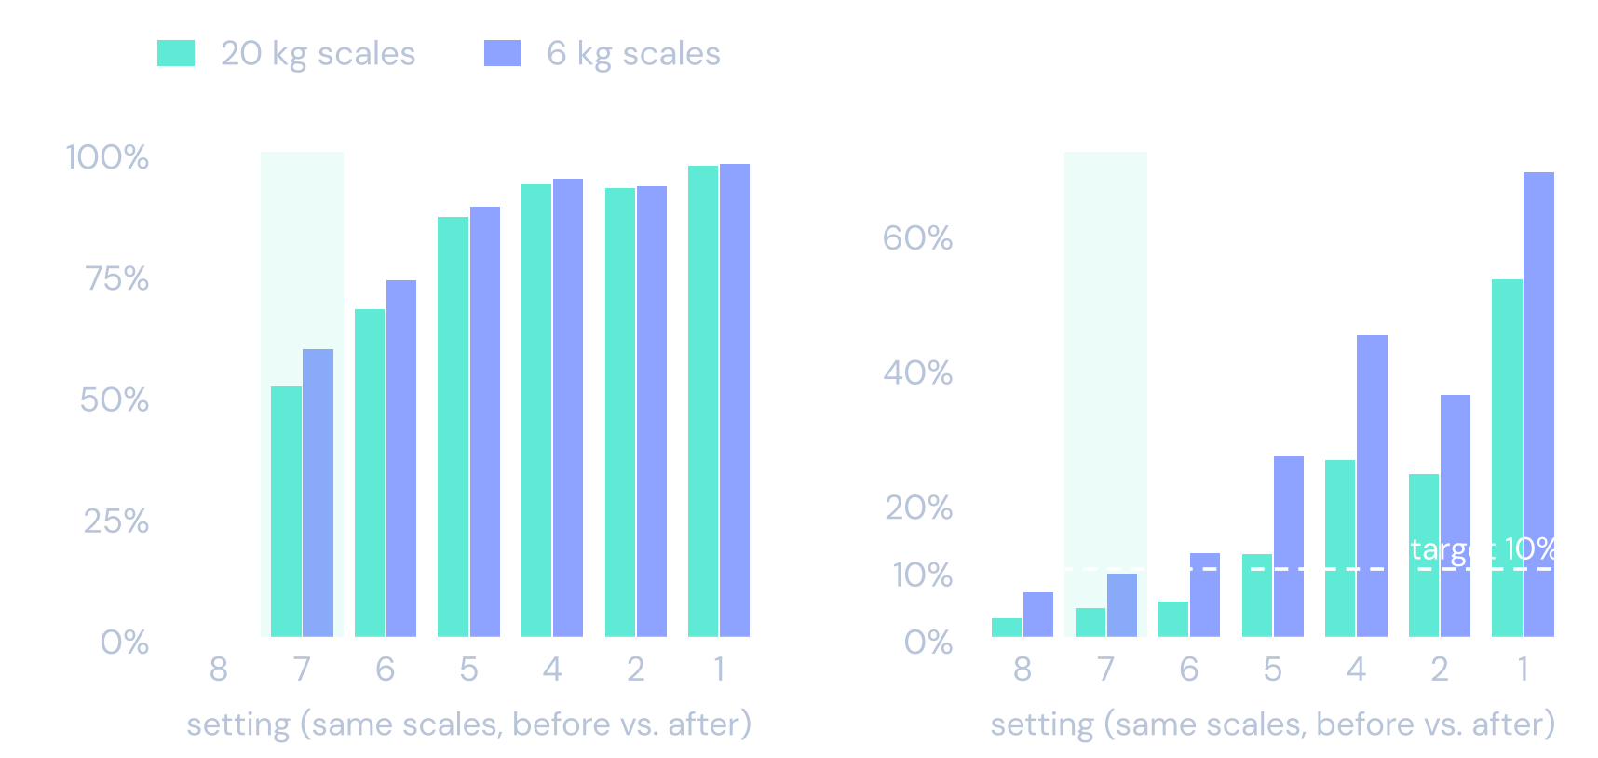
FINDING 2 · THE SETTING
One step down halves the empty wake-ups for almost no extra missed picks
−52% / −59%
empty wake-ups when the setting goes from 8 to 7 (20 kg / 6 kg)
4% / 9%
of picks missed on 7, still under the 10% target
Below setting 6, the scale starts to miss real picks.
Source: own analysis of the Bossard SmartBin data, 1 Mar to 20 Jun 2022 · 624 + 1,080 scales that went from 8 to 7, before and after, minus the trend of unchanged scales · Report §5.1
6
Notes:
Now, what does the setting really do?
In April Bossard changed the setting of thousands of scales. We compare each scale with itself, before and after, and subtract what happened to scales that stayed on 8.
The first step, from 8 to 7, removes about half of the empty wake-ups. For a typical 20 kg scale that is from about thirteen to about six a week.
The price is small. Missed picks go from about 3 to about 4 percent on 20 kg scales, and from about 7 to about 9 percent on 6 kg scales. Both stay under the 10 percent line.
Below setting 6 the scale starts to miss real picks, and 6 kg scales cross the line first.
So the first step is cheap. The deep steps are expensive. This is the most important measured result of our work.

Slide 7
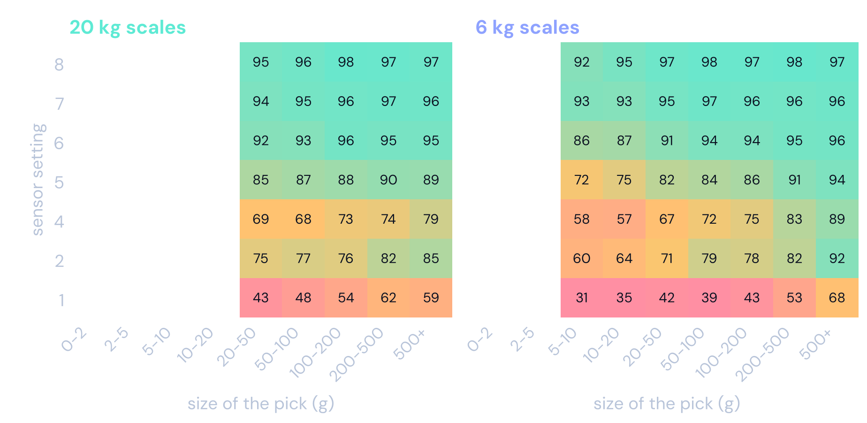
FINDING 2 · PICK SIZE
Small picks are hard to see. They need a high setting or a 6 kg scale.
Each cell is the share of picks the scale caught (%).
A 20 kg scale cannot see picks under about 23 g at any setting.
From setting 5 down, the scale misses more picks of every size.
Parts picked in very small amounts belong on 6 kg scales.
Source: own analysis of the Bossard SmartBin data, 1 Mar to 20 Jun 2022 · empty cells: too few picks, or below what the scale can see · Report §4.6
7
Notes:
How much a scale misses also depends on the size of the pick.
Each cell shows the share of picks the scale caught, by setting and by the size of the pick.
A 20 kg scale cannot see a pick of a few grams at any setting. Below about 23 grams it is blind. A 6 kg scale sees down to about 5 grams.
Settings 6 to 8 catch almost every pick. From setting 5 down the scale misses more and more, whatever the size.
So parts that are picked in very small amounts belong on 6 kg scales.

Slide 8
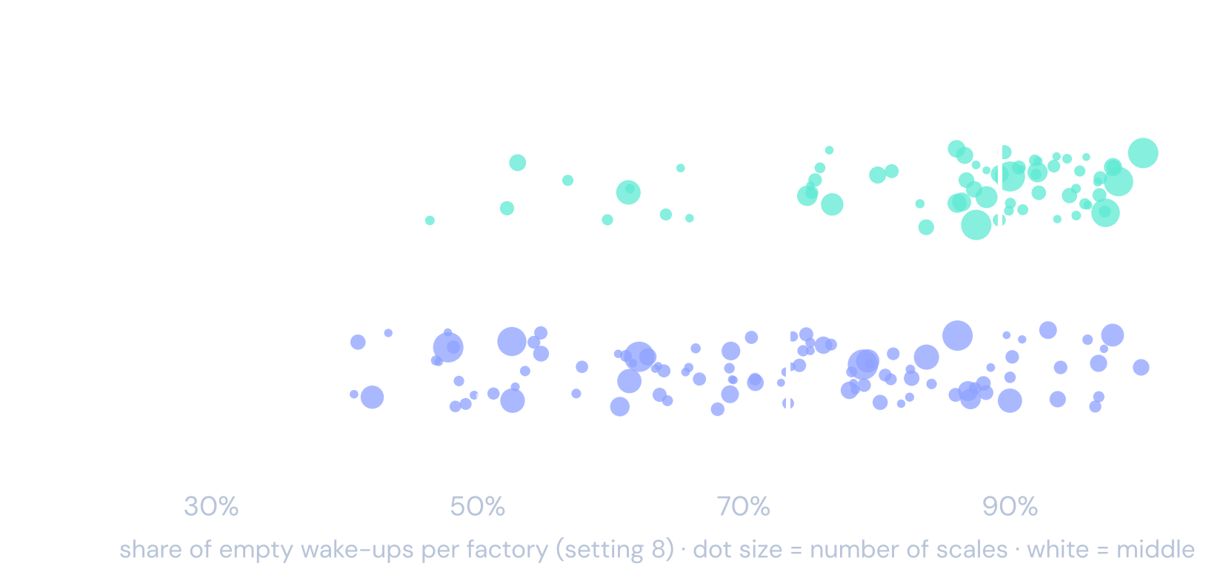
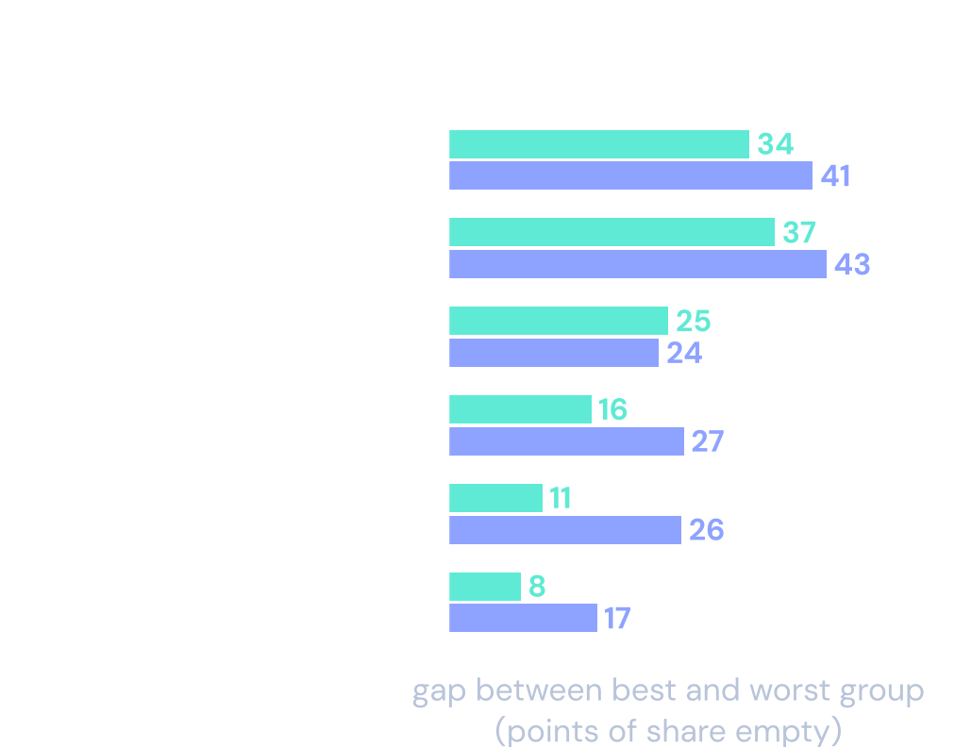
FINDING 3 · NO ONE SIZE FITS ALL
The same setting works differently in every factory
What decides the best setting only shows once a scale is running. So each scale should learn its own setting.
Source: own analysis of the Bossard SmartBin data, 1 Mar to 20 Jun 2022 · factories with at least 20 scales, default setting · gaps in percentage points · Report §4.7, §4.8
8
Notes:
Can we not just pick one good setting for everyone?
No. On the left, every dot is a factory, all on the same setting. Some factories are close to the target, others are far above it.
The numbers on the right are percentage points. Take the factory. In the best factories about 63 percent of the wake-ups are empty, in the worst about 97 percent. The gap is about 34 points. How often a bin is used matters about as much.
Box type and item weight matter much less. But those are the only things Bossard knows before a scale is installed.
So the best setting cannot be looked up in the master data. Each scale has to learn it.

Slide 9
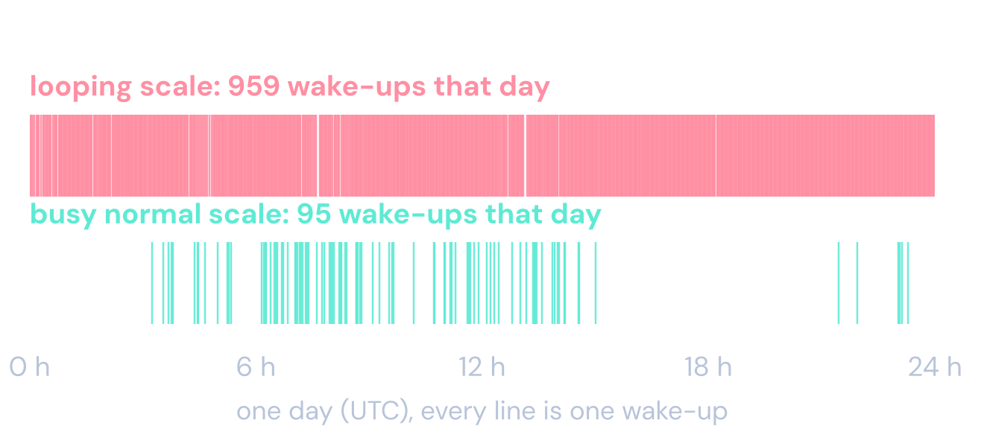
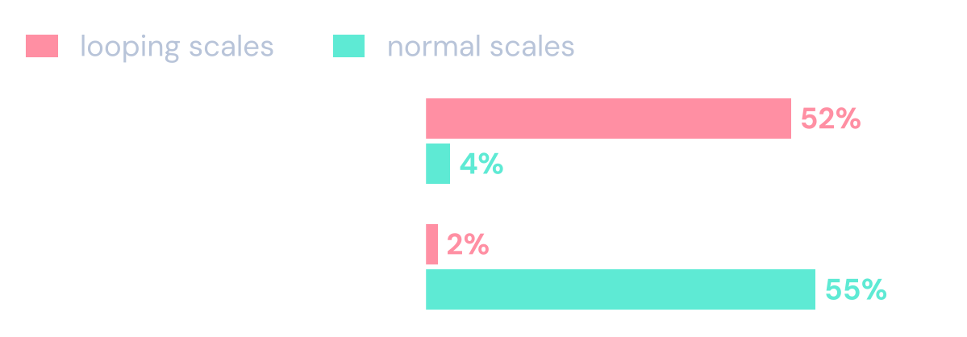
FINDING 4 · LOOPING SCALES
1.5% of the scales wake themselves up and cause 27% of all weighings
The same scales act normally on another setting (215 of 215). This points to the firmware, not to broken hardware.
The check uses only the time between wake-ups, so time zones do not matter.
About every 90 seconds, all day long. That is the shortest pause the scale allows between two wake-ups (60 s) plus the time it waits before it weighs (30 s).
We took these scales out and repeated every analysis. The results hold.
Source: own analysis of the Bossard SmartBin data, 1 Mar to 20 Jun 2022 · looping = over half of the wake-ups within 2 min and over 20 a day · Report §5.3, Appendix C
9
Notes:
Our next finding was the biggest surprise.
A small group of scales wakes itself up again and again. The top line on the left is one of them. Every line is one wake-up. Below it is a busy but normal scale.
The looping scale wakes up about every 90 seconds, all day long. Ninety seconds is the shortest pause the scale allows, sixty seconds, plus the thirty seconds it waits before it weighs. So the scale triggers itself as soon as it is allowed to.
On the right we compare these scales with normal ones. Half of their wake-ups come about 90 seconds after the last one. And almost none of them come when someone picks nearby. So these wake-ups are not caused by people.
Only 1.5 percent of the scales do this. But they cause 27 percent of all weighings. Most of them during a short test of setting 3 in April.
The same scales behave normally on another setting. So the hardware is fine. This looks like a firmware problem.
We removed these scales and repeated all our analyses. The results did not change.

Slide 10
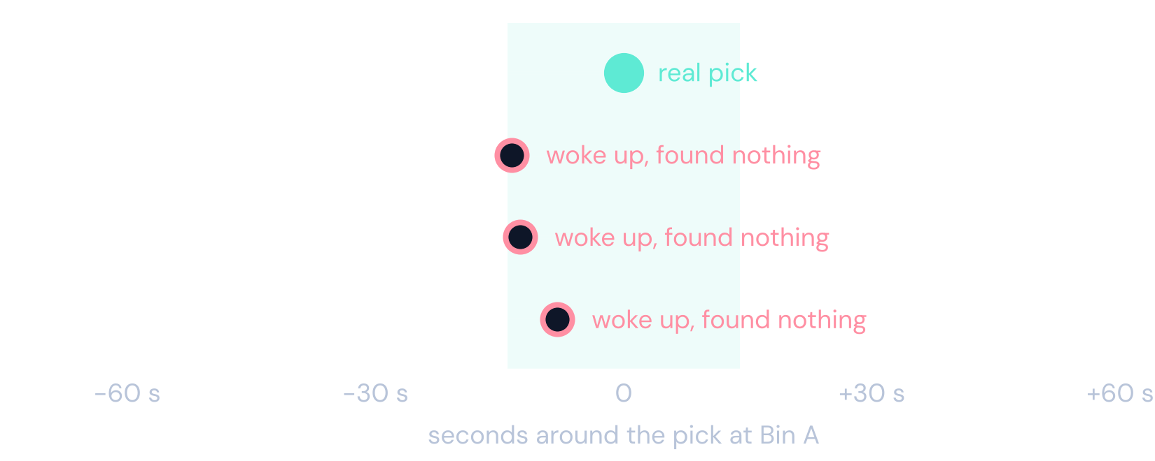
A SIGNAL TO CHECK · PICKS NEARBY
Many empty wake-ups come within seconds of a pick nearby
A REAL EXAMPLE FROM THE DATA
55%
of empty wake-ups come within 14 s of a pick at the same site, above chance
WHAT IS STILL OPEN
Which bins share a shelf. The data only knows the site.
How the shaking travels. A short vibration test on site would show it.
Then: a damping pad could be tested.
A worker picks from Bin A. Three other bins at the same site wake up within 14 seconds and find nothing.
Source: own analysis of the Bossard SmartBin data, 1 Mar to 20 Jun 2022 · looping scales left out (45% with them) · the checks are in the backup · Report §4.5, Appendix C
10
Notes:
We also found a signal that we did not expect.
Here is one real moment from the data. A worker takes parts from Bin A. In the same seconds, three other bins at the same site wake up. They weigh and find nothing.
Across the data, more than half of the empty wake-ups come within 14 seconds of a real pick at the same site. That is after we remove what would happen by chance.
We see this as a signal, not as a proven result. The data only knows the site, not which bins share a shelf.
To act on it, Bossard would need the rack positions and a short vibration test on site. Then a damping pad under the scales could be tested.
Our checks of this signal are in the backup.

Slide 11
OUR RECOMMENDATION
Flag, tune, watch
F
Flag
T
Tune
W
Watch
Find looping scales every day and send them to service.
Start every scale on 7. Every two weeks it moves one step, or stays.
Track KPI 2.0. Keep the daily check. Watch the few scales that miss most.
274 scales, 27% of weighings
8 → 7: −52% / −59% empty
misses stay visible
NOW
WEEKS 1 TO 8
THEN
Start the loop check · default 8 → 7
Test the rule in about 10 factories
Roll out to all scales
Source: own analysis of the Bossard SmartBin data, 1 Mar to 20 Jun 2022 · effects measured on real scales · Report §5 and §6
11
Notes:
Our recommendation has three steps. None of them needs new hardware. Everything runs on data the cloud already has.
Flag. Find the looping scales every day and send them to service. They cause 27 percent of all weighings.
Tune. Every scale starts on setting 7. We measured that this step alone removes about half of the empty wake-ups. Every two weeks the scale can move one more step, or stay.
Watch. Track the new KPIs. Keep the daily safety check. Look closer at the few scales that miss most picks.
We suggest to start the first part now, and to test the rule in about ten factories for eight weeks.

Slide 12
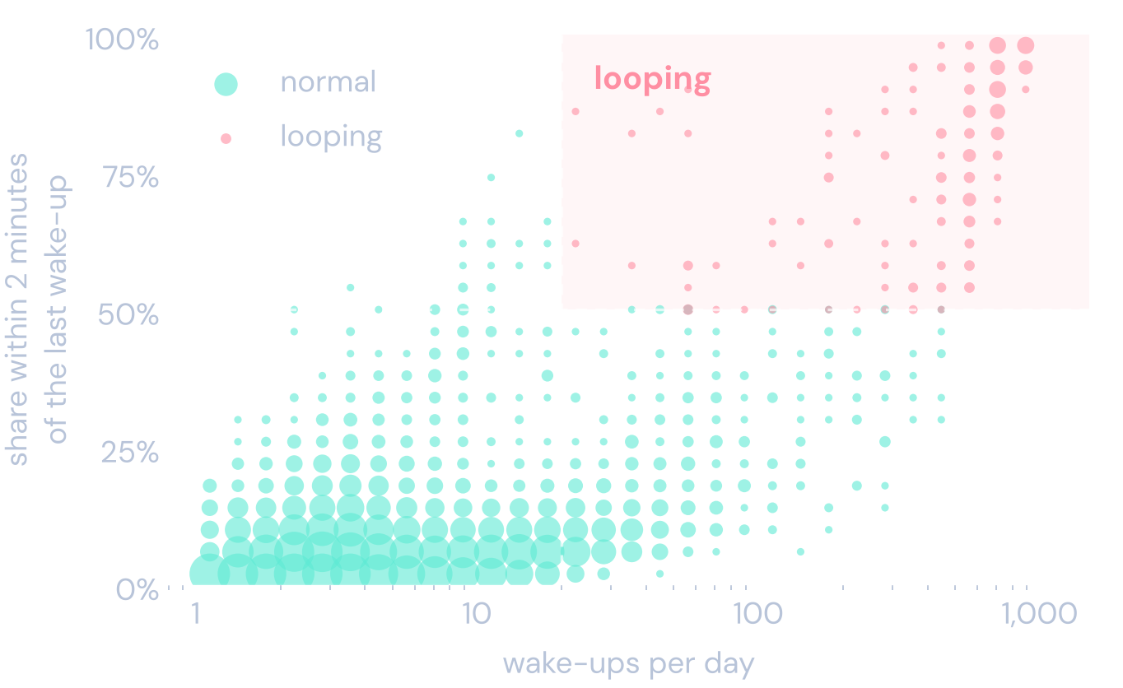
STEP 1 · FLAG
A simple daily check finds the looping scales
A SCALE IS LOOPING IF, OVER THE LAST WEEK
more than half of its wake-ups come within 2 minutes of the last one, and
it wakes up more than 20 times a day.
THEN
1
Set it back to 7 from the cloud
2
Still looping after 2 days → service visit
3
Send the list to the firmware team
Looping and normal scales are far apart. Other thresholds give almost the same list.
Source: own analysis of the Bossard SmartBin data, 1 Mar to 20 Jun 2022 · each dot = scales with similar values · Report §5.3, Appendix C
12
Notes:
How do we find a looping scale? With two simple numbers.
How often does it wake up again within two minutes? And how many times a day does it wake up?
If more than half of the wake-ups come that fast, and it wakes up more than 20 times a day, it is looping.
The chart shows why this is easy. Normal scales sit bottom left. Looping scales sit top right. Even the busiest normal scales stay far from the line.
Then three steps. Set the scale back to 7 from the cloud. If it still loops after two days, send service. And give the list to the firmware team.

Slide 13
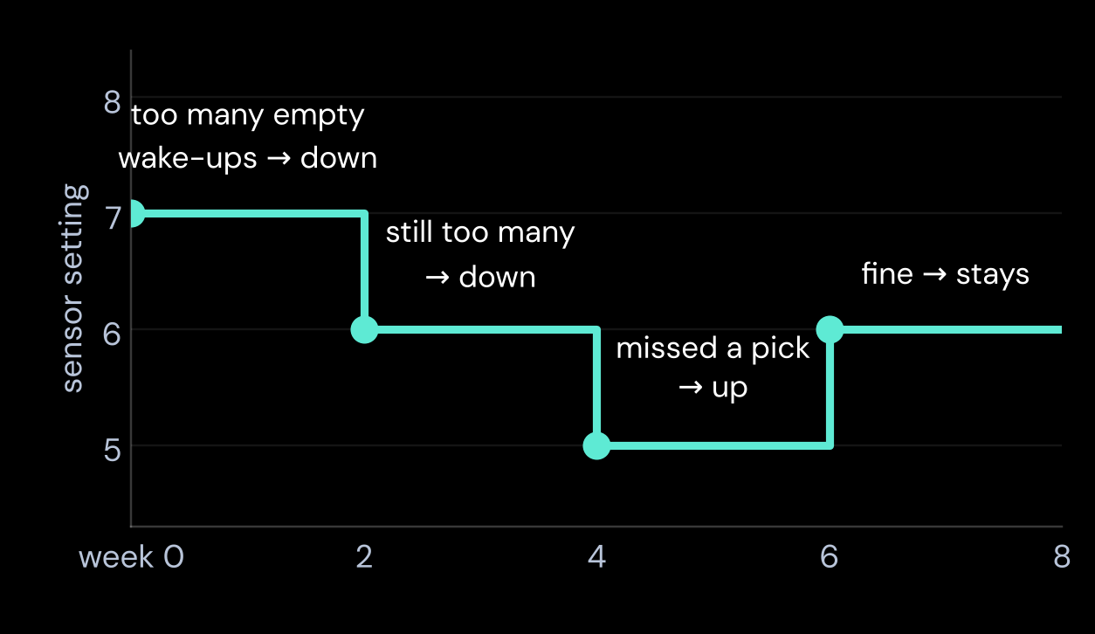
STEP 2 · TUNE
Every two weeks, each scale moves one step, or stays
EVERY 2 WEEKS, FOR EACH SCALE
EXAMPLE · A BUSY 20 KG SCALE
Missed more than 10% of its picks, or more than 2 a week?
one step MORE sensitive
More than 7 empty wake-ups a week, and almost no misses?
one step LESS sensitive
Neither?
stay
Every scale starts on setting 7. Setting 3 is never used.
The thresholds are the KPI 2.0 targets.
Each move is one step. The measured effect of each step is on the setting slide.
Illustrative example · the rule is to be tested in the pilot · Report §6.2
13
Notes:
This is the heart of the solution, and it is simple.
Every two weeks the cloud looks at each scale.
Did it miss more than 10 percent of its picks, or more than two a week? Then it becomes one step more sensitive.
Did it wake up for nothing more than seven times a week, with almost no misses? Then it becomes one step less sensitive.
Otherwise it stays where it is.
The thresholds are simply the KPI 2.0 targets.
On the right is an example. A busy scale starts on 7 and steps down twice. On 5 it misses a pick, so it goes back up to 6. There it stays.
We do not claim an exact saving for the rule. The first step from 8 to 7 is measured. The rest should be tested in a pilot.

Slide 14
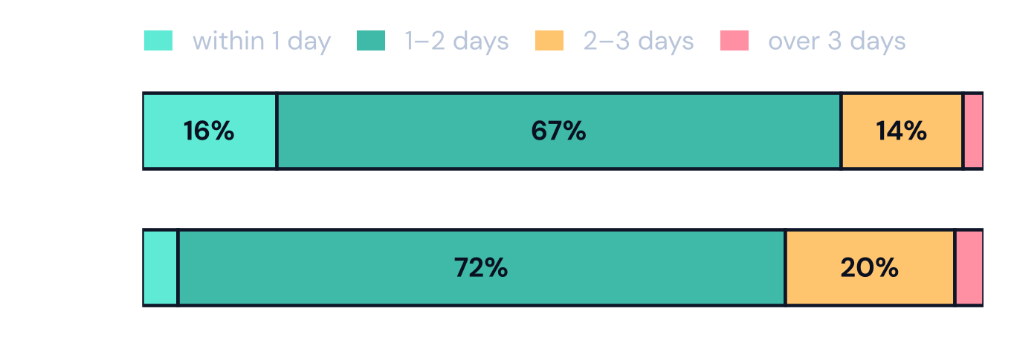
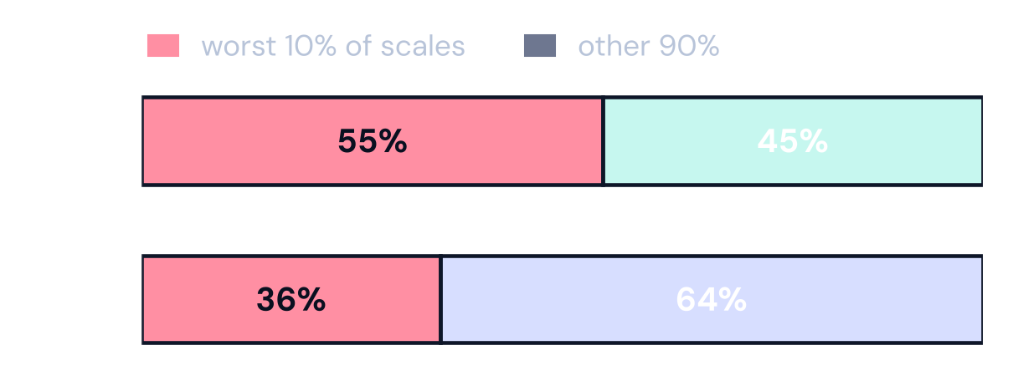
STEP 3 · WATCH
Missed picks are still found, usually within two days
WHEN IS A MISSED PICK FOUND?
WHO MISSES THE PICKS?
KPI 2.0, EVERY WEEK
Two numbers per scale: empty wake-ups ≤ 7 and picks missed ≤ 10%. Bossard's daily check already finds 91% of the misses. The scales that miss most go on a watch list.
Keep the daily check
Extra check for the worst 10%
Alarm if a scale is silent for 48 h
Source: own analysis of the Bossard SmartBin data, 1 Mar to 20 Jun 2022 · time since the last weighing of every missed pick · Report §3, §6.4
14
Notes:
A fair question is this. If the sensor sleeps more, does the stock stay wrong for days?
The data says no. A missed pick is found by the next weighing of that bin. That can be the next wake-up, or the daily check. Bossard already weighs every scale that was quiet for 24 hours. Most missed picks are found within one or two days.
A few take longer. We suggest an alarm for any scale that has been silent for two days.
On the right you see that misses are concentrated. The worst ten percent of the scales cause about half of all misses. Those scales get an extra check.
So every week the dashboard shows two numbers per scale. Empty wake-ups and missed picks. That is KPI 2.0 in daily use.

Slide 15
NEXT STEPS
Start the safe steps now. Let a pilot decide the rest.
NOW
PILOT · 8 WEEKS
IN PARALLEL
LIMITS
Run the daily loop check
Remove setting 3 from the menu
Default setting 8 → 7
Report KPI 2.0 for every scale
Rule in about 10 factories
Compare with similar factories without it
Measure weighings and missed picks
Check the picks-nearby signal on site
Firmware fix for the loops
Confirm how the daily check works
Only one season of data
The April change was not random
Some missed picks are never seen
Time stamps in UTC, no local time
No shelf positions in the data
Our advice for today: start the loop check and the new default 7 now. Both are low risk and measured. Let the pilot decide the details of the rule.
Source: own analysis of the Bossard SmartBin data, 1 Mar to 20 Jun 2022 · Report §7 and §8
15
Notes:
What should Bossard do on Monday?
Two things are safe and can start now. The daily loop check, and the new default setting of 7. We measured both on real scales.
The rule itself goes into an eight-week pilot in about ten factories. We compare them with similar factories that keep the old setting, and measure weighings and missed picks.
In parallel, the signal of picks nearby should be checked on site, and the firmware team can fix the loops.
Our limits are simple. One season of data, the April change was not random, and the time stamps are in UTC, so we did not analyse local working hours. That is why we want a pilot first.

Slide 16
THANK YOU
Questions?
F
Flag
find the looping scales every day
T
Tune
every scale learns its own setting
W
Watch
keep missed picks visible
Erenalp Çakıroğlu and Nikolaos Georgantopoulos · Group 3 · code, report and pipeline in a private repository (case data under NDA)
Notes:
Thank you. We are happy to take your questions.

Slide 17
BACKUP · DATA CHECKS
What we removed, and what we kept
Check | Rows | What it means | Action
Duplicate rows | 5,733 | Same scale, same time to the millisecond | deleted
Impossible weights | 5 | 144 kg to 50 t on a 20 kg scale | deleted
Duplicates with two labels | 1,300 | One copy says missed, the other OK | kept, label not used
Label missing | 9,886 | No OK, empty or missed label | kept, not in KPIs
Setting missing | 399,956 | The sensor setting is empty | kept, not in KPIs
Other wait time or delay | 57,400 | Non-standard trigger settings, e.g. a 60 min wait | kept, not in KPIs
Scale type or site unknown | 212,758 | Not in the scale list, cannot tell 6 kg from 20 kg | kept, not in KPIs
Too short periods | 325,938 | Under 5 days or 20 weighings on one setting (D ONE rule) | kept, not in KPIs
Setting 3 | 1,327,327 | Four-week trial in April, studied apart | studied apart
Rare settings | 287 | Used by fewer than 30 scales of a type | kept, not in KPIs
5.26 M of 7.60 M rows (69%) are used for the KPIs. Only 5,738 rows were deleted. The rest stay in the data, because the next weighing needs them to compute its weight change.
Source: own analysis of the Bossard SmartBin data, 1 Mar to 20 Jun 2022 · Report §3, Appendix A
17
Notes:
We deleted only rows that were clearly broken. Duplicate rows and five impossible weights.
Everything else stays in the data, but some rows are not used for the KPIs. For example rows without a sensor setting, or scales we could not find in the scale list.
In the end we work with 69% of all rows, about 5.3 million weighings.

Slide 18
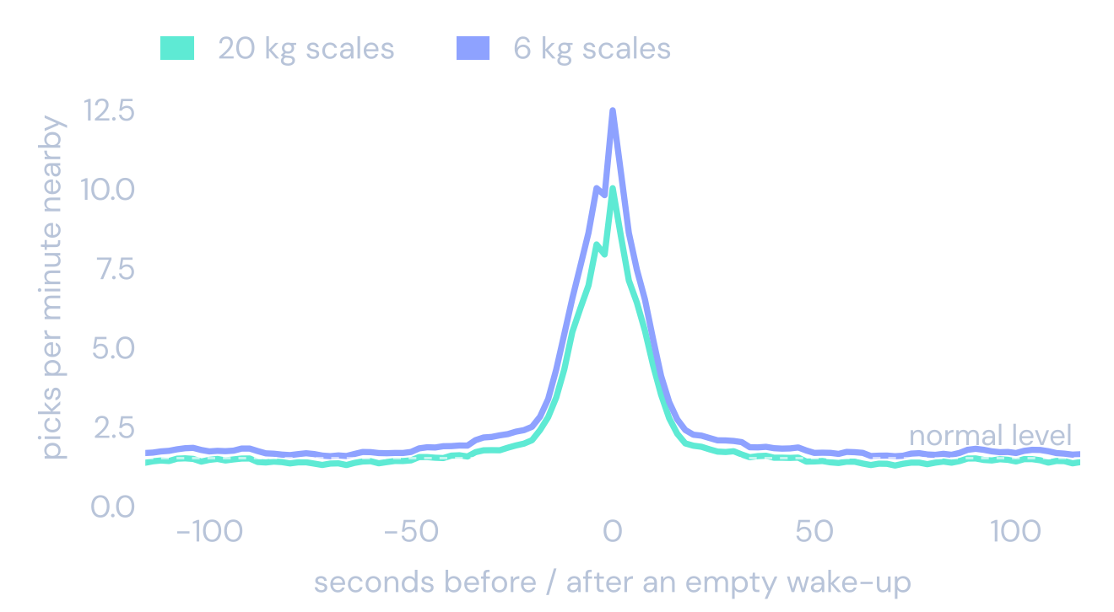
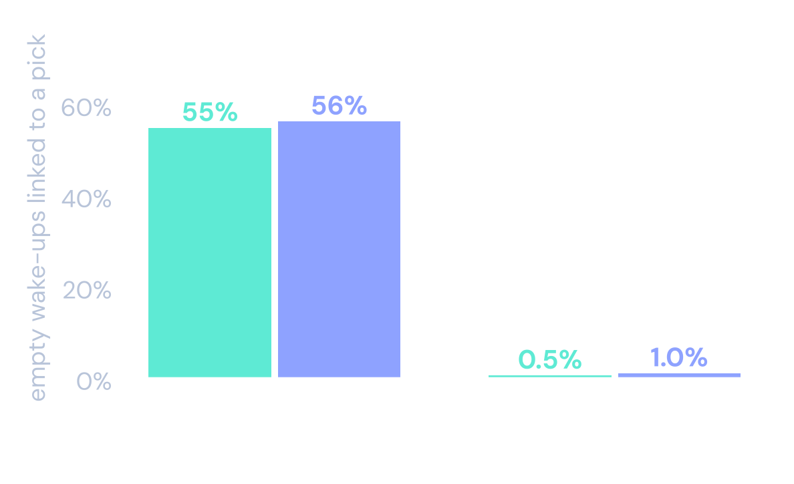
BACKUP · PICKS NEARBY
How we checked the signal, and what it cannot show
✓
Peak at zero
✓
Not just a busy hour
✓
Not the clock
!
Not equally strong
Around an empty wake-up, picks at other bins of the site are about 8 times more frequent than normal.
One minute later, in the same hour, only 25% have a pick nearby, against 66%.
Picks in another factory at the same second show no link.
On most scales, 45% to 78% of the empty wake-ups are linked. Shelf positions are unknown.
Source: own analysis of the Bossard SmartBin data, 1 Mar to 20 Jun 2022 · event coincidence analysis (Donges et al., 2016) · Report §4.5, Appendix C
18
Notes:
We checked the signal in three ways.
On the left, around an empty wake-up, picks at the other bins jump to about eight times the normal level, exactly at zero seconds.
One minute later, in the same busy hour, the link is gone. So it is not just a busy time of day.
On the right, picks from a different factory at the same second show no link.
How strong the link is differs a lot between scales, between 45% and 78% for most of them. And we do not know which bins share a shelf. So it stays a signal to check on site.

Slide 19
BACKUP · ROBUSTNESS
Without the looping scales, every key result holds
Result | All scales | Without looping scales
Empty wake-ups per week, typical scale (20 kg / 6 kg) | 13.5 / 8.5 | 13.5 / 8.4
Setting 8 → 7: fewer empty wake-ups | 59% / 68% | 52% / 59%
Setting 7: picks missed, typical scale | 4% / 10% | 4% / 9%
Empty wake-ups linked to picks nearby | 45% | 55%
3 looping scales left their looping setting and later came back to it. 2 of them looped again. Setting 3 was never used again after the April trial.
Source: own analysis of the Bossard SmartBin data, 1 Mar to 20 Jun 2022 · report/robustness_loops.py · Report Appendix C
19
Notes:
We removed the looping scales and ran everything again.
The typical scale looks the same. The effect of the setting stays in the same range. Missed picks on setting 7 stay low.
The link to picks nearby gets stronger, because the looping scales wake up when nobody is there.

Slide 20
BACKUP · BATTERY
Most of the battery goes into sleep
WHAT WE ASSUMED
The case description says that a scale uses about 3,000 times more power while it measures than while it sleeps. How long one measurement takes is not given. We assumed 2 seconds and show 1 and 5 seconds as well.
SHARE OF THE BATTERY USED WHILE SLEEPING
One measurement takes | 1 s | 2 s (our assumption) | 5 s
Typical 20 kg scale (2.5 weighings a day) | 92% | 85% | 69%
Typical 6 kg scale (2.0 weighings a day) | 94% | 88% | 75%
So fewer weighings help the battery much less than the network and the cloud. We do not give a battery saving in the main deck.
Assumption from the case description Bossard / D ONE (2026), measurement time assumed · radio transmission not modelled · Report §6.3
20
Notes:
The battery is not in the data. We used the case description. A scale uses about three thousand times more power while it measures than while it sleeps.
How long a measurement takes is not given. We assumed two seconds.
Then one weighing costs as much energy as about one and a half hours of sleep. A typical scale weighs only two or three times a day. So most of the energy goes into sleep, about 85% for a 20 kg scale.
Even with five seconds per weighing it is still about 69%.
That is why fewer weighings help the battery much less than the network and the cloud.

Slide 21
BACKUP · METHODS
Three methods, each answering one question
Does the setting cause the change?
Are empty wake-ups linked to picks?
How small a pick can a scale see?
Each scale before and after its change in April, minus the change of scales that kept their setting (difference in differences).
Count picks at other scales of the same factory within 14 s, minus the chance level one minute later (event coincidence analysis).
The weight change behind each label. Below about 23 g (20 kg) or 5 g (6 kg) a pick is invisible.
Angrist & Pischke (2009) · Donges et al. (2016) · Green & Swets (1966) · Report Appendix A
21
Notes:
Each question has its own method.
For the effect of the setting we compare each scale with itself before and after its change, and subtract what happened to scales that kept their setting.
For the link to picks nearby we count picks around every empty wake-up and subtract the chance level.
For pick size we look at the weight change behind every label.

Slide 22
BACKUP · CODE
One pipeline from raw data to this deck
Step | What it does
Load and check | load 7.6 M rows into DuckDB, delete broken rows, mark the rest
Build tables | weight change per weighing; one record per scale and setting
Analyse | today, the setting, parameters, factories, pick size, loops, picks nearby
Validate | synthetic test data with known answers. The pipeline must find them first.
Report | summary tables, figures, the written report and this deck
Robustness | every key result again without the looping scales
RUN IT
bash run_bossard.sh
python report/build_figures.py
python report/robustness_loops.py
quarto render report/report.qmd
python presentation/build_cto_deck.py
Raw data never goes into the repository. Only summary tables do.
Source: project repository (private)
22
Notes:
Everything in this deck can be rebuilt from the three raw files with these five commands.

